Slide 1

Academy Web Solution
CHEST DISEASES
Represented by
Sara Mohamed
Moamen Elaiashy
Aliaa Wasel
Hagar Mansour
Mayar Ashraf
Mostafa Ashraf

Slide 2

Agenda
❏ introduction
❏ Project Overview
❏ Project Structure
❏ Front-End Technologies
❏ Back-End Technologies
❏ Project Database(ERD)
❏Project Restful API

Slide 3

Introduction
An academic system that facilitates the process of managing the academy and saves the data of each of the students, users, branches, and each of the courses and materials offered by the academy to students, and facilitates financial transactions for the user.

Slide 4
Project Overview
Ability to register academy instructors and employees as system users.
Ability to make groups for the system users, each group can have different permissions on the system.
Ability to register academy branches each with its supervisor name, phone number, … etc.
Ability to register course subjects (Course can contain many subjects, and no the opposite).
Ability to register academy trainees.
Ability to register trainee financial transactions regarding payment of a course, or more than one course.

Slide 5
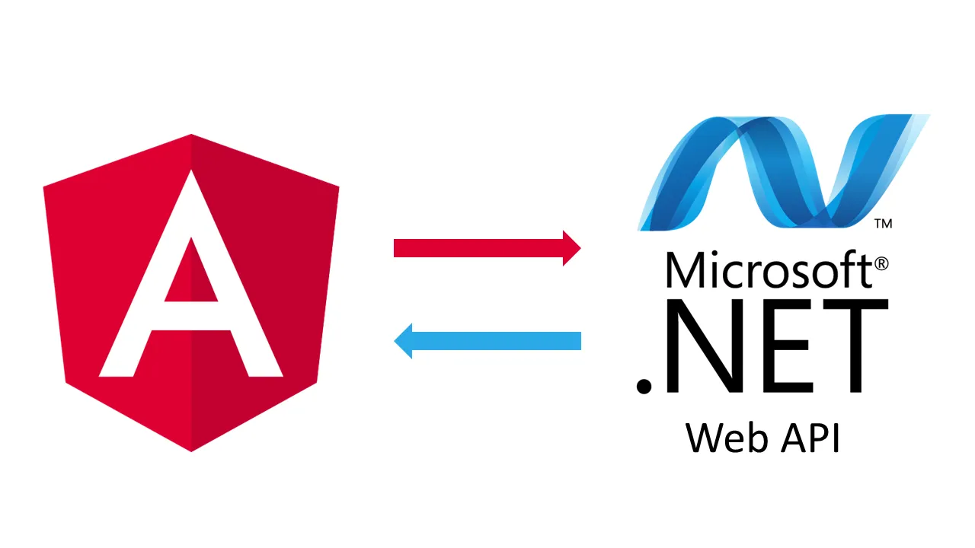
Project Structure
Back-End
Front-End

Slide 6





Front-End Technologies

Slide 7


Back-End Technologies
❏ Microsoft SQL Server (For Database).
❏ Microsoft ASP.NET Web API 2.2 (With Controllers) (For Back-End Application)

Slide 8
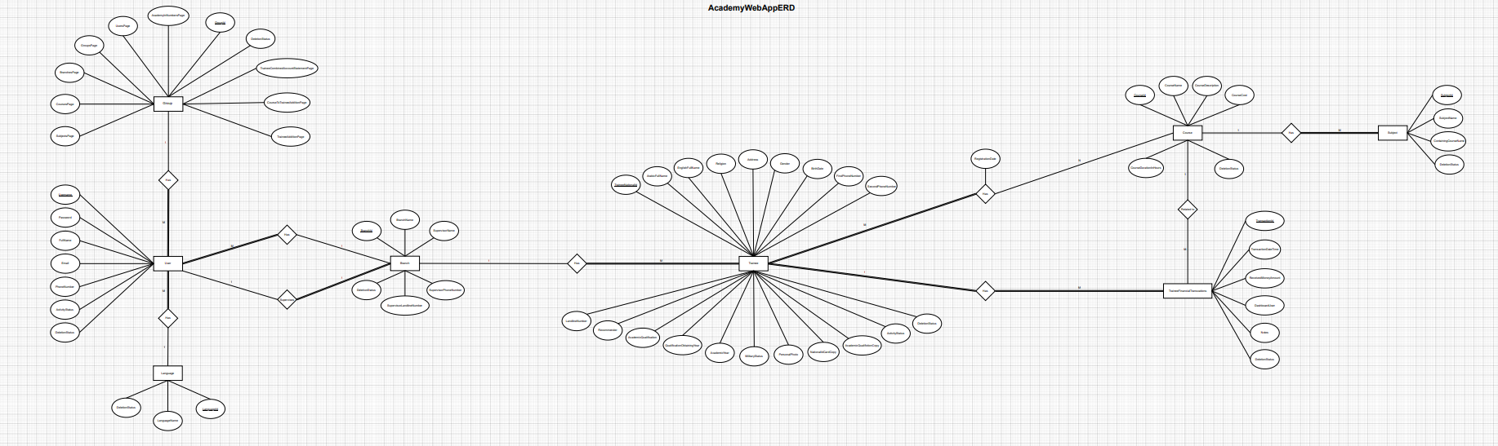
Project Database(ERD)

Slide 9
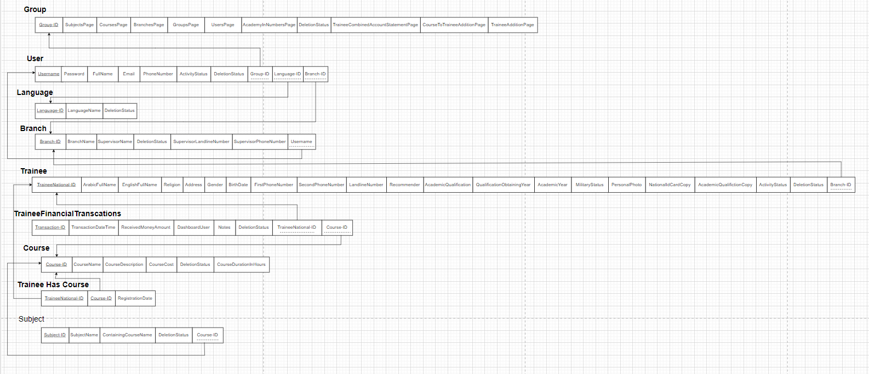
Project Database

Slide 10

Project Restful API
We have used the microsoft’s tool of ASP.NET Web API (With Controllers), and adapted the design architecture of N-Layers with Repository design pattern, and finally ended up with a project that have the following four layers:
❏ Models Layer.
❏ Repositories Layer.
❏ Data Transfer Objects (DTOs) Layer.
❏ Controllers Layer

Slide 11


UI Implementation Let’s explore the real system…

Slide 12
Any Qusetions?

Slide 13

Thank you For Your Attention

